Slide 1
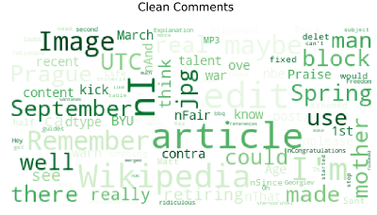
MALIGNANT COMMENT CLASSIFICATION

Slide 2
INTRODUCTION
People Use social Media as a platform to express their opinions and views.
They do this freely and without any reluctance.
With it comes the risk of cyber abuse and harassment, which can put an end to people expressing themselves and giving up on seeking opinions.
To protect the user from cyberbullying every organization should have an automated system in place to identify such malicious comments and suitable actions against the same.

Slide 3
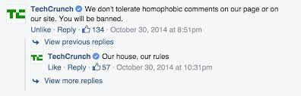
OBJECTIVE
We have undertaken this project to classify the comments made by different users on social media platforms, like the tweets from Twitter in this case, to build a model that is capable of detecting and classifying these tweets into various classes like threat, obscene, insult and identity-based hate.

Slide 4
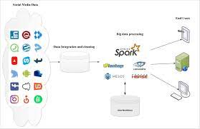
DATA EXTRACTION
We started out by using the online social media platform for example twitter, facebook, insta etc. in Python to extract the comments .
We collected the comments containing the cuss words using the track parameter to gather relevant data to perform our analysis.
We saved the data gather from online social media platform in a CSV File.

Slide 5
PREPROCESSING OF THE DATA
We have performed the following pre-processing on the data:
Removed Punctuation
Removed the stop words
Stemming and lemmatization
Applied counter vectorizer

Slide 6
DATA MODELLING
Problem Transformation method
We used the Multinomial Naïve Bayes classifier for classification
We used this classifier, since it is suitable for classification with the discrete features.
The algorithm estimates the conditional probability of a particular word given a class as the relative frequency of term in documents belonging to class.
The variation takes into account the number of occurrences of term in training documents from class include multiple occurrences.

Slide 7
DATA MODELLING
Adaptation Algorithms
We used the Backpropagation for Multilabel Learning algorithm.
The BPMLL algorithm is a back-propagation neural network algorithm adapted for multi-label classification by having multiple binary outputs as the label variables.
It helped to classify the tweets in real-time as the algorithm changes its behavior at the time it is run, based on information available and on a priori defined criterion.

Slide 8
DATA VISUALIZATIONS

Slide 9
DATA VISUALIZATIONS

Slide 10
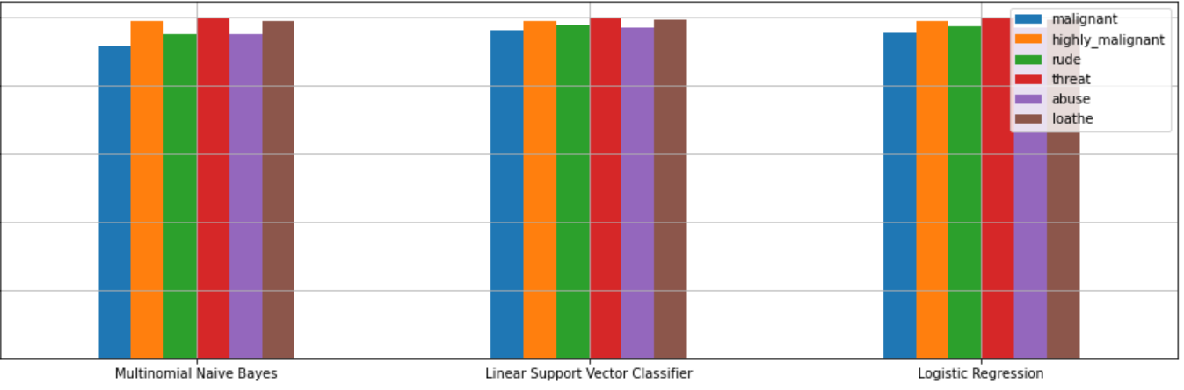
ANALYSIS OF RESULTS

Slide 11
CHALLENGES
Multiple labels – For Binary classification we have many models available but for multilabel classification the selection of models decreases drastically.
Collection of USABLE DATA – although we extracted over 100000 records, only 14000 records were usable among them.
Cleaning the data – Due to the character limit tweets contain a lot of short forms which are different to classify using bag of words model.
TWITTER RATE LIMIT – Due to the twitter rate limit we were getting timed out every 15 mins due to which the data collection process took over 8 hours.

Slide 12
FUTURE SCOPE
The current project predicts the type or toxic in the comment.
We are planning to add the following features in the futures.
Analyze which age group is being toxic towards a particular group or brand.
Add feature to automatically sensitize words which are classified as toxic.
Automatically send alerts to the concerned authority if threats are classified as severe.
Build a feedback loop to further increase the efficiency of the model.
Handle mistakes and short forms of words to get better accuracy of the result

Slide 13
Thank you

